Slide 1
Smart Hospitals Analysis
Rolls John
Company : ITC
Designation : Data Engineer

Slide 2
Contents
Introduction
Business value
Problem Statement
Pipeline
Findings
Results

Slide 3
Introduction
Smart hospitals
which utilize data and AI insights to facilitate decision-making at each stage of the patient experience
can provide medical professionals with insights that enable better and faster care.
Difference Between a Smart Hospital and a Traditional Hospital
Hospitals are continuously generating and collecting data, much of which is now digitized. This creates an opportunity for them to apply such technologies as data analytics and AI for improved insights

Slide 4
Business value
Understand the type of Hospitals in different regions
Categorize the type of hospitals with specialties
Analyses of infrastructure availability
Based on the analysis improving healthcare sector

Slide 5
Problem Statement
Retrieve all required data from source-Extraction
Transformation-Data cleaning and aggregation that prepares it for analysis
Loading-Extracted and transformed data is loaded into the end target.

Slide 6
Data Analysis - Load the dataset for analysis
- Perform cleaning and handle the outliers.
-Test the model and perform analysis for real time dataset.
- Evaluate the performance of the model
Data Visualization – Understand patterns
- Communicate information
- Explore data
- Make Informed decisions

Slide 7


Pipeline
Ingestion
ETL
Data Science
Machine Learning
Batch
Business Intelligence
Analytics
Streaming
Data Source
Raw data
Curated
Data Consumer

Slide 8


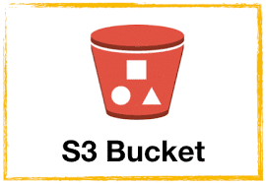

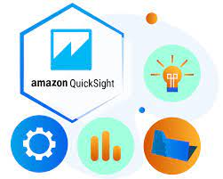




Raw Data
Curated Data
Visualization
Ingestion
Transformation
Batch data
Glue Crawler
Data Streaming
S3 trigger
Analysis
Glue Catalog
Athena
Kinesis

Slide 9
Findings
Total beds available on hospitals with different categories and regions
Analyze Availability of hospitals in different states

Slide 10
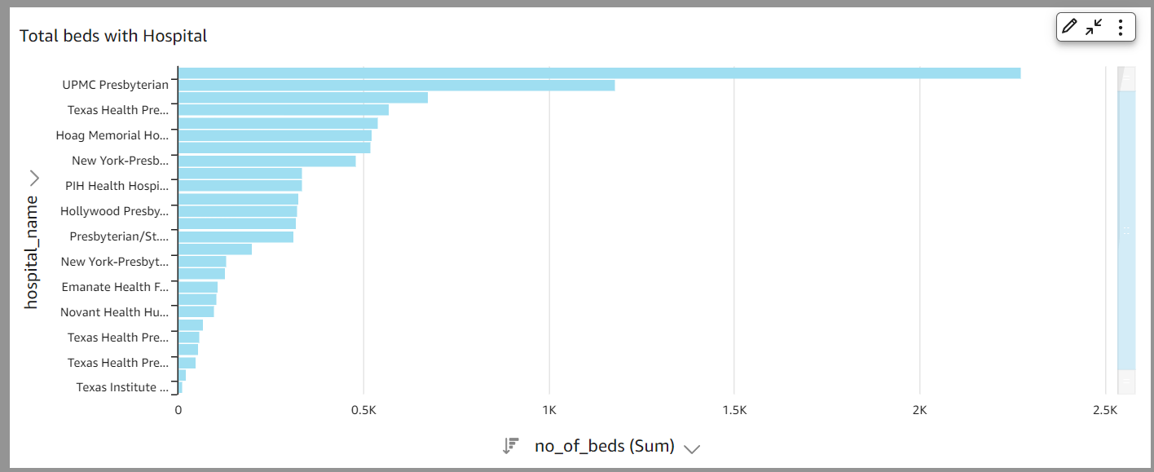
Results

Slide 11
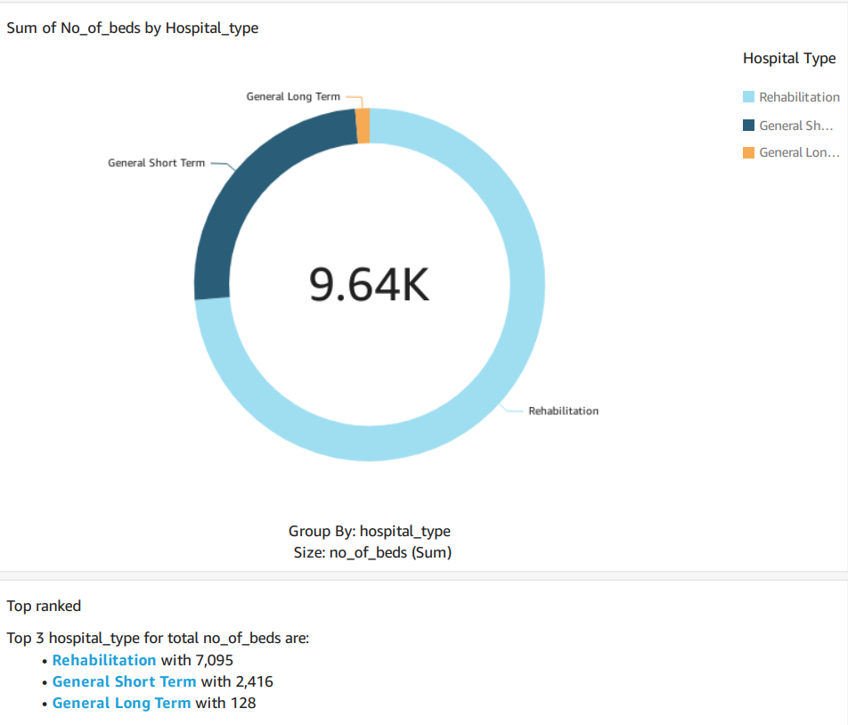

Slide 12
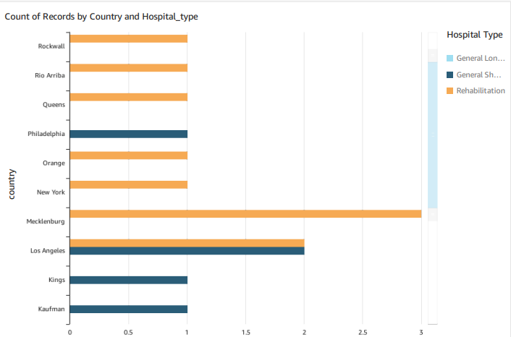

Slide 13
Future Work
Increase the data size, with more analysis parameters
Implement other services

Slide 14
Thank You

